Slide 1







Location determination for restaurant opening in Toronto Analysis Report
Amit Kumar
25-Dec-2020

Slide 2



OUTLINE
Executive Summary
Introduction
Methodology
Results
Visualization – Charts
Dashboard
Discussion
Findings & Implications
Conclusion
Appendix

Slide 3

EXECUTIVE SUMMARY
The project deals people interest in the selected destination
Analysis Zone
People Interest in the City
Restaurant Counts in that area
Demographics
Determine where to open the restaurant

Slide 4

INTRODUCTION
Nature of Analysis : Graphical Analysis and Analytical
Problem: To identify where to invest in restaurant business
What’s now
People Interest
Restaurant Crowd

Slide 5

METHODOLOGY
We have collected data from various resources like
Wikipedia Page
Foursquare API
We have cleaned the data
We figure the outliers and removed it
We plot the different graphs to view the relationship

Slide 6
RESULTS
Our analysis shows that general Restaurant, Chinese and Breakfast item dining, and other category has more effect in Toronto.
Based on the less distance from city center and less restaurant we have following cities:
York,
Etobicoke
East York
East Toronto
Central Toronto
Based on the People interest:
Downtown Toronto
East York
Scarborough

Slide 7
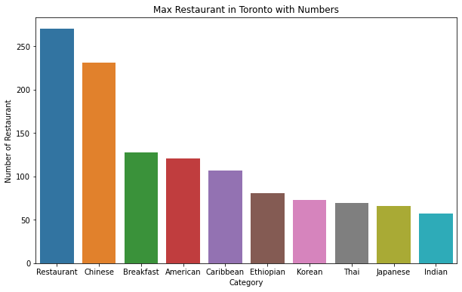
Restaurant in Toronto

Slide 8
Restaurant in Toronto- FINDINGS & IMPLICATIONS
Findings
General Restaurant are domination
Chinese, American, Caribbean are also favorite
Also preferred Breakfast type dining.
Implications
We can go for anyone these categories as per our comfortability.

Slide 9
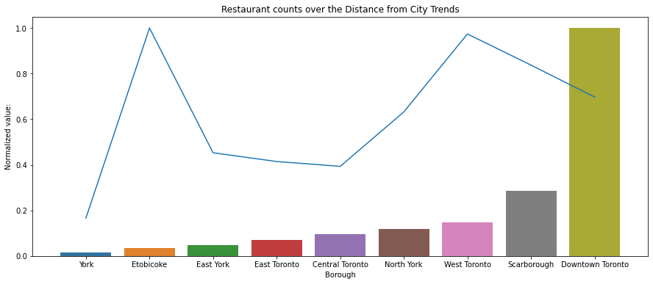
Distance and Restaurant count relation

Slide 10
Distance and Restaurant count relation- FINDINGS & IMPLICATIONS
Implications
These cities can be the point of investment
Findings
Top 5 cities which has less no of restaurant and also are less far from city center
York,
Etobicoke
East York
East Toronto
Central Toronto

Slide 11

Notebook
https://github.com/amitkumar8636/Coursera_Capstone_Location_Analysis/blob/main/Capstone_Applied_DS.ipynb

Slide 12

Report
https://github.com/amitkumar8636/Coursera_Capstone_Location_Analysis/blob/main/Capstone_Applied_DS_Report.pdf

Slide 13
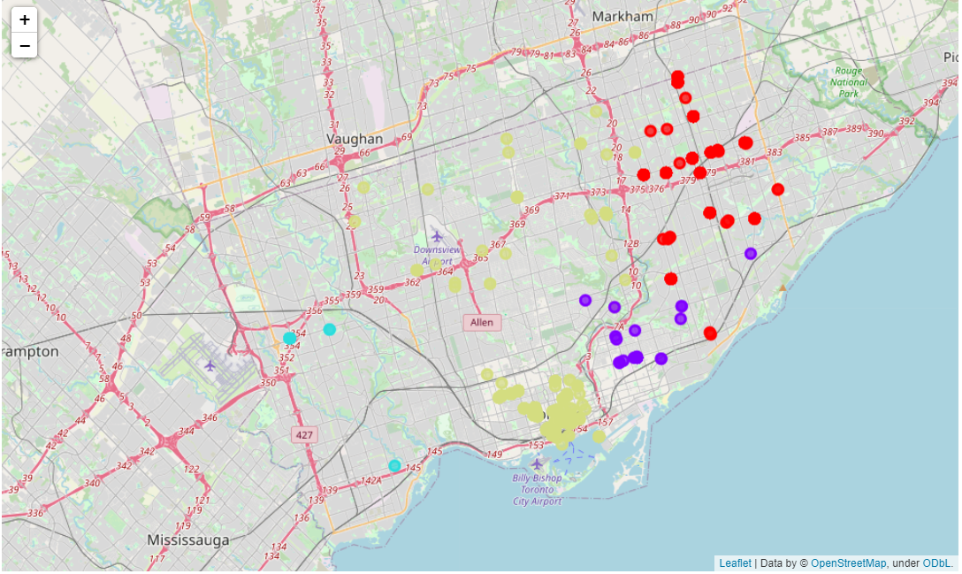
Cluster

Slide 14

DISCUSSION
So, Where you Planning to open the Restaurant Now
?

Slide 15

CONCLUSION
Being competitive in the market you must choose the location based on the determination
Always keep people interest in mind
You can move little towards Coastal Area for the office
Chose some security and other geographical detail before final decision

Slide 16

APPENDIX
The data is captured through Foursquare API and some data is captured though Wikipedia site scrapping.

